Slide 1
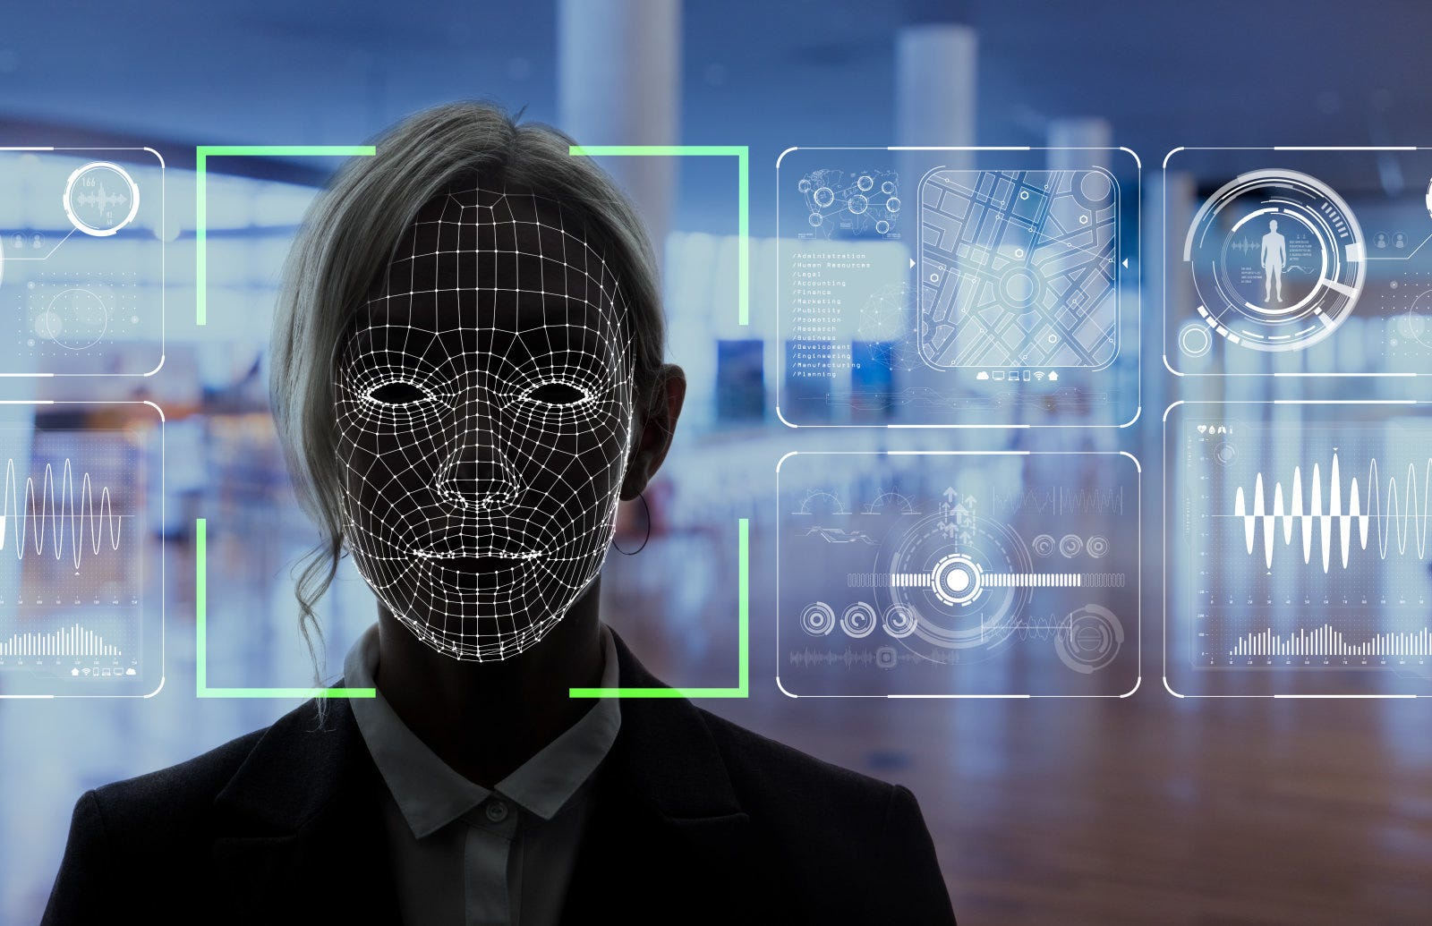
SMIT MEMON SOCIETY CAMPUS
Face Recognition
Attendance System
Students:
Teacher
Junaid
Ayan Ali
Abdul Basit
Umair Qureshi
Huzaifa
Sir Yasir Nawaz

Slide 2
Technology Overview
Introduction to Face Recognition
What is Face Recognition?
Applications
A biometric technology that identifies or verifies individuals by analyzing and comparing patterns based on the person's facial contours. It captures, analyzes, and compares patterns based on the person's facial details.
Security Systems
Access Control
Attendance Tracking
Identity Verification
Smart Devices
Law Enforcement
Market Growth
Core Components
Global Market Size (2024)
$5.2B
Face Detection: Locating faces in images
Feature Extraction: Converting faces to numerical vectors
Projected (2030)
$12.5B
Face Matching: Comparing with stored embeddings

Slide 3
Challenges
Problem Statement
Impact Analysis
Manual Attendance
Time-Consuming: 5-10 minutes per class
Time Wasted Daily
Human Error: Incorrect entries, missed names
Paper Records: Difficult to maintain & search
Data Entry Errors
RFID/Card Systems
Need for Solution
Lost/Stolen Cards: Security vulnerability
Educational institutions need an automated, contactless, and accurate attendance system that eliminates manual processes, prevents proxy attendance, and provides real-time digital records with minimal human intervention.
Buddy Punching: One student marks for another
Replacement Cost: $5-15 per card

Slide 4
Our Approach
Proposed Solution
Face Recognition Attendance System
An intelligent, automated system that uses computer vision and machine learning to identify students through facial features and mark attendance in real-time without any physical contact or manual intervention.
Benefits
Real-time
Contactless
99%+ Accuracy
1
Instant recognition & marking
No physical interaction needed
Reliable face recognition
2
<2 Seconds
Secure
Digital
Per student recognition
Prevents proxy attendance
Automated record keeping
3
Zero Proxy
Eliminates buddy punching
Key Features
Webcam Integration
ML-Powered
Live video capture
Random Forest classifier
Web Interface
Background Training
Flask + JavaScript
Threading support

Slide 5
Goals
Project Objectives
01
Automated Recognition
03
User-Friendly Interface
Develop a fully automated face recognition system that can accurately identify students and mark attendance without manual intervention, reducing administrative workload by 90%.
Create an intuitive web-based interface using Flask and JavaScript that allows easy student registration, real-time attendance monitoring, and report generation with minimal training.
02
High Accuracy
04
Secure Database
Achieve minimum 95% accuracy in face detection and recognition under various lighting conditions and angles, ensuring reliable attendance tracking for all students.
Implement SQLite database with proper schema design to store student information, face embeddings, and attendance records securely with data integrity and backup capabilities.
05
Scalable Training
Enable background model training using Python threading to allow continuous system operation while updating the recognition model with new student data, ensuring zero downtime.

Slide 6
System Design
System Architecture
Face
Detection
Image
Collection
Feature
Extraction
Model
Training
Face
Recognition
Attendance
Marking
Database
Storage
Data Flow
Core Components
Interactions
1
Student registration with face capture
Flask Web Server
Frontend ↔ Backend
2
OpenCV detects and crops faces
Handles HTTP requests, serves UI
AJAX calls for real-time updates
3
Feature vectors extracted & stored
ML Pipeline
Backend ↔ Database
4
Random Forest model trained
Face detection, embeddings, training
SQL queries via SQLite3
5
Real-time recognition & attendance
SQLite Database
Backend ↔ ML Model
Stores students, attendance records
Pickle for model serialization
Threading Module
Background training process

Slide 7
Tech Stack
Technologies Used
Python
NumPy
Pickle
Core Language
Numerical Computing
Serialization
Primary programming language for backend logic, ML model implementation, and system integration
Efficient array operations, mathematical computations on face embeddings, matrix manipulations
Python object serialization for saving and loading trained ML models and face embeddings
Random Forest
Flask
SQLite
ML Model (sklearn)
Web Framework
Database
Ensemble learning classifier for face recognition, handles high-dimensional embeddings efficiently
Lightweight WSGI web framework for building RESTful APIs and serving the web interface
Lightweight disk-based database for storing student data, attendance records, and face embeddings
OpenCV
Threading
Computer Vision
JavaScript
Concurrency
Image processing, face detection using Haar Cascades, video capture from webcam
Frontend
Python threading module for background model training without blocking the main application
Dynamic UI interactions, AJAX requests, real-time webcam integration, DOM manipulation

Slide 8
Data Pipeline
Dataset Collection & Preprocessing
Image Collection Process
Preprocessing Steps
1
Student Registration
Face Detection
Enter student details (Name, ID, Department)
OpenCV Haar Cascade detects faces in images
2
Webcam Capture
Capture 50 images per student
Face Cropping
Variation Capture
Extract only the face region from full image
3
Different angles, expressions, lighting
Resizing
4
Organized Storage
Standardize to 100x100 or 150x150 pixels
Images saved in student-specific folders
Grayscale Conversion
Reduce dimensionality, improve processing speed
Dataset Structure
Dataset Statistics
dataset/
├── student_001/
50
100×100
├── img_001.jpg
├── img_002.jpg
Images per student
Standard image size
└── ... (50-100 images)
├── student_002/
├── img_001.jpg
└── ...
Grayscale
.jpg/.png
└── student_00N/
Color format
Image formats

Slide 9
Feature Extraction
Face Embedding Extraction
What are Face Embeddings?
Visual Representation
Face embeddings are numerical vector representations that encode unique facial features into a high-dimensional space. Each face is converted into a fixed-size vector (typically 128 or 512 dimensions) that captures distinctive characteristics.
Face Image
Embedding
# OpenCV Feature Extraction
face_roi = image[y:y+h, x:x+w]
embedding = model.predict(face_roi)
Extraction Process
1
Load preprocessed face image
Key Properties
2
Apply OpenCV face detection
Uniqueness
3
Extract facial landmarks & features
Each person has distinct embeddings
4
Generate numerical feature vector
Consistency
Same face produces similar vectors
Compactness
128-512 dimensions vs. 10,000+ pixels

Slide 10
Machine Learning
Model Training: Random Forest
Random Forest Classifier
Training Process
An ensemble learning method that constructs multiple decision trees during training and outputs the class that is the mode of the classes (classification) of individual trees.
1
Data Preparation
Collect embeddings (X) and labels (y)
2
Bootstrap Sampling
Create random subsets with replacement
# sklearn Implementation
3
Tree Construction
from sklearn.ensemble import RandomForestClassifier
Build 100 decision trees in parallel
model = RandomForestClassifier(
4
Voting Mechanism
n_estimators=100,
Majority vote for final prediction
max_depth=20,
Model Persistence
random_state=42
5
)
Save with Pickle for future use
Hyperparameters
Why Random Forest?
High Accuracy
n_estimators
Number of trees: 150
Handles High Dimensions
random_state
Feature Importance
Reproducibility: 42
Fast Prediction

Slide 11
Data Storage
Database : SQLite
SQLite Advantages
Database Schema
students
Lightweight
File-based
• roll number
• registration number
Reliable
• name
Fast
• class
• section

Slide 12
Process Flow
System Workflow: Step-by-Step
1
Registration
2
Preprocessing
3
Embedding
Student provides details and captures face images via webcam
Face detection, cropping, resizing, and grayscale conversion
Extract 128-dimensional feature vectors from processed faces
50 images
OpenCV operations
128D vectors
4
Training
5
Recognition
6
Storage
Random Forest model trained on embeddings with student labels
Real-time face detection and recognition during attendance
Attendance records saved to SQLite database with timestamp
sklearn RF
Live video
SQLite DB
Complete Data Flow Diagram
Register
Dataset
Train
Recognize
Mark
Report

Slide 13
Frontend
User Interface: Flask + JavaScript
Tech Stack
Interface Components
HTML5
CSS3
Structure
Styling
Dashboard
Overview of attendance statistics, daily summary, quick actions
Registration Page
JavaScript
Flask
Student data entry form with integrated webcam capture
Interactivity
Backend
Attendance Interface
Real-time video feed with face detection overlay and status
Key Features
Reports & Analytics
Responsive Design
Attendance history, filter by date/student, export to Excel File
Works on desktop, tablet, mobile
AJAX Requests
Asynchronous data loading
Real-time Updates
Live attendance status display

Slide 14
Core Functionality
Attendance Marking Process
Process Visualization
Real-Time Workflow
1
Video Capture
Webcam streams video to Flask backend
2
Face Detection
OpenCV Haar Cascade detects faces in frame
3
Feature Extraction
Convert detected face to 128D embedding
Performance Metrics
4
Model Prediction
Random Forest predicts student ID
Confidence Check
<2s
95%+
5
Verify prediction confidence > threshold (0.7)
Recognition Time
Accuracy
6
Database Update
Record attendance with timestamp
0.7
30fps
Confidence Threshold
Video Stream

Slide 15
Concurrency
Background Model Training
Why Threading?
Threading Architecture
Model training can take several minutes depending on dataset size. Without threading, the web application would freeze during training, making it unusable.
Main Thread
Flask Server
# Problem: Blocking Training
def train_model():
Training Thread
model.fit(X, y) # Blocks for 5-10 min
Model Training
# App is frozen!
Solution: Threading
Benefits
Zero Downtime
# Non-blocking Training
App remains responsive during training
import threading
Better UX
def train_model():
Users see progress indicators
model.fit(X, y)
thread = threading.Thread(
Scalable
target=train_model
Handle multiple training requests
)
Real-time Updates
thread.start() # Non-blocking!
Training status notifications

Slide 16
Benefits
System Advantages
Contactless
Fast & Efficient
Digital Records
No physical contact required, hygienic solution especially important in post-pandemic scenarios
Recognition in under 2 seconds per student, significantly faster than manual roll call
Automated digital attendance storage with easy search, filter, and export capabilities
No Proxy
High Accuracy
Cost-Effective
Eliminates buddy punching and proxy attendance completely through biometric verification
95%+ recognition accuracy with proper lighting and camera positioning
No special hardware needed, uses existing webcams, free open-source software stack
90%
0%
<2s
24/7
Time Saved
Proxy Rate
Per Student
Availability

Slide 17
Enhancements
Future Improvements
Deep Learning Models
Cloud Integration
Mobile Application
Integrate CNN architectures like FaceNet, DeepFace, or OpenFace for significantly higher accuracy and better feature extraction.
Migrate to cloud platforms (AWS, Azure, GCP) for scalability, remote access, automatic backups, and reduced infrastructure costs.
Develop Android/iOS app for students to view attendance, receive notifications, and enable mobile-based check-ins.
99%+ accuracy potential
Unlimited scalability
Enhanced accessibility
Multi-Face Detection
ERP Integration
Enable simultaneous recognition of multiple faces in a single frame for faster group attendance marking in classrooms.
Connect with existing university management systems (ERP, LMS) for seamless data synchronization and unified reporting.
5x speed improvement
System interoperability

Slide 18
Summary
Conclusion
Technical Learnings
Computer Vision
OpenCV for face detection and image preprocessing
Project Achievements
Machine Learning
Feature extraction, model training, and evaluation
Successfully Automated Attendance
Eliminated manual roll calls and paper-based systems
Web Development
High Recognition Accuracy
Flask backend with responsive JavaScript frontend
Achieved 95%+ accuracy with Random Forest classifier
User-Friendly Web Interface
Concurrency
Intuitive Flask + JavaScript frontend for easy operation
Python threading for non-blocking operations
Secure Database Implementation
SQLite with proper schema design and data integrity
Background Training Support
Threading enables zero-downtime model updates
Real-World Potential
This system demonstrates practical application of AI/ML in educational institutions. With future enhancements like deep learning and cloud integration, it can be deployed at scale across universities and colleges worldwide.
95%+
<2s
100%
0%
Accuracy Achieved
Recognition Speed
Automation
Proxy Attendance

Slide 19
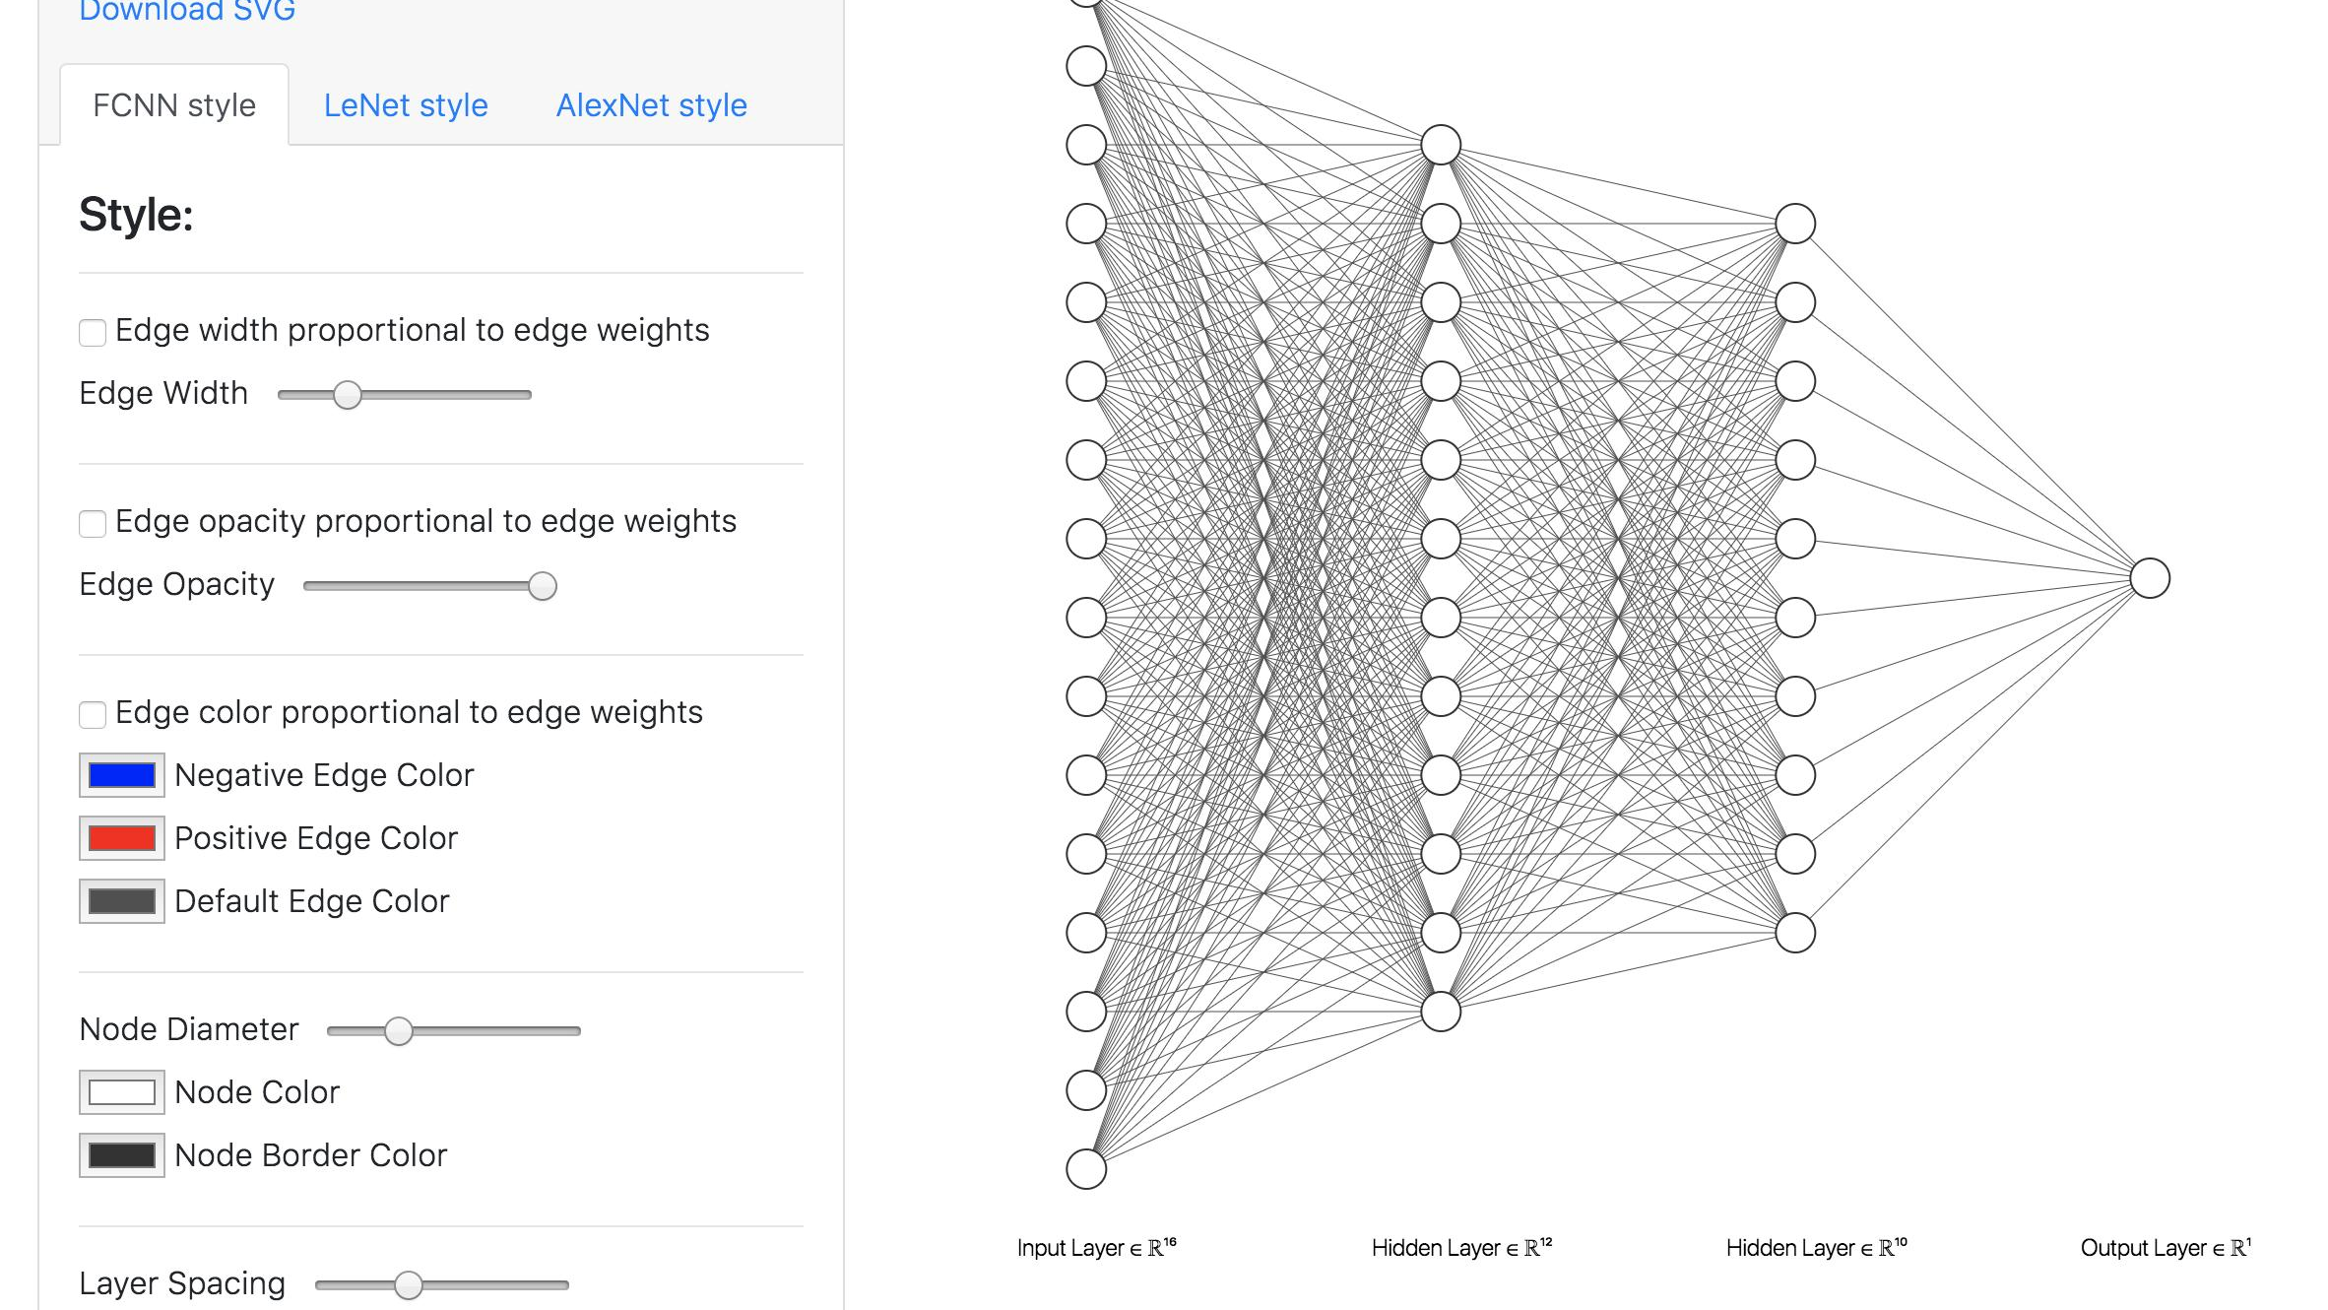
Thank You

